Slide 1


SUMMER TRAINING PROJECT REPORT
By Jagan Mohan Reddy

Slide 2
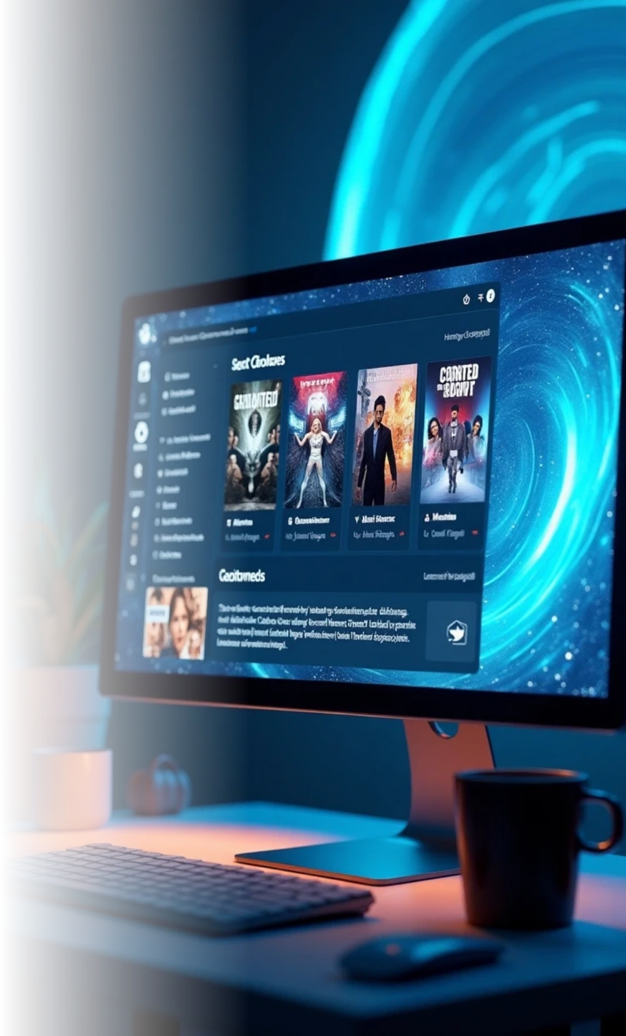
Title of the Project
Hybrid Movie Recommendation System Using Deep Learning with Content-Based and Collaborative Filtering

Slide 3

CONTENTS
1. INTRODUCTION
2. PROJECT OVERVIEW
3 . IMPLEMENTATION
4 RESULTS AND DISCUSSION
5. CONCLUSION

Slide 4

01
INTRODUCTION

Slide 5

Objective of the Project
The main goal of my project is to create a movie recommendation system that does two things:
• Suggest the top N movies for a user based on their past ratings, so I can get personalized suggestions.
• Find the top N movies similar to a movie entered by the user , based on its content, like genres or themes.
Since I enjoy movies and anime, I wanted a system that feels personal and helps me discover new shows or films.
The system should be easy to use, with a web page where users can enter their ID or a movie title and get recommendations.
It uses deep learning and some part statistics to make smart suggestions, combining what users like with movie details to give the best results possible.

Slide 6

02
PROJECT OVERVIEW

Slide 7


Tools and Technologies Used
1
Python
2
PyTorch
The main programming language I used to write all the code.
A tool for building neural networks, which I used for my recommendation model.
3
Pandas and NumPy
4
Scikit-learn
For working with data, like organizing movie ratings and details.
For splitting data, scaling numbers, and checking how well the model works.
5
Flask
6
Matplotlib
To create a web page where users can get movie recommendations.
For making graphs to show the model’s results, like how close predictions are to actual ratings.

Slide 8


Areas Covered During Training
Data Preprocessing: Cleaning and preparing data so the computer can use it properly.
Supervised Learning: Teaching the computer to predict things, like movie ratings, based on examples.
Neural Networks: Building models that act like a brain to find patterns in data, which I used for my recommendation system.
Recommendation Systems: Learning how to suggest items based on what users like or item details, like movie genres.
Model Evaluation: Checking if the model’s predictions are good using numbers like error rates.
Web Deployment: Putting the model online so users can interact with it through a web page.

Slide 9

03
IMPLEMENTATION

Slide 10

DATA PREPROCESSING: To prepare the raw data into a form usable by the machine learning model.
What was done:
Step | Description
Loading CSVs | Read user ratings, movie metadata, and content features from CSV files
Merging data | Combined user ratings with movie metadata based on movieId
Label Encoding | Converted user and movie IDs into integers (for embedding layers) using LabelEncoder
TF-IDF Vectorization | Applied TfidfVectorizer to the content field (genres, overview, tags) to get a vector representation of each movie
StandardScaler | Scaled the ratings using StandardScaler to make them mean=0 and std=1
Train-Test Split | Split the full dataset into training and test sets (80%–20%) randomly

Slide 11

Training The Models
.
1. CBF (Classical Content-Based Filtering – TF-IDF + Cosine Similarity)
TF-IDF vectors are generated using TfidfVectorizer on movie content (genres, overview, tags).
Cosine similarity is computed between movies using these TF-IDF vectors.
No training or learning happens—it's a static mathematical computation.
Used only for recommending similar movies based on content, not user preferences.
Efficient and interpretable, but can't adapt or learn from user behavior.

Slide 12
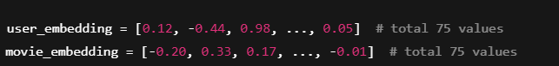
2. CF (Collaborative Filtering using Embeddings)
Users and movies are encoded as integers and passed into nn.Embedding layers.
Both embeddings have a size of 75 and are initialized randomly.
These embeddings learn user preferences and movie traits through training.
Backpropagation updates the embedding weights based on how well the model predicts ratings.
The CF embeddings are concatenated with CBF embeddings during hybrid training.
.

Slide 13

3. Neural CBF (Content-Based Branch inside Hybrid)
TF-IDF vectorinput into two dense layers: Linear(input → 256) and Linear(256 → 128).
s are ReLU activation and Dropout (0.3) are applied between layers for non-linearity and regularization.
These layers learn to extract important content features useful for rating prediction.
Backpropagation is used to update the weights during training based on rating loss.
The output is a 128-dimensional CBF embedding vector passed into the hybrid model.

Slide 14


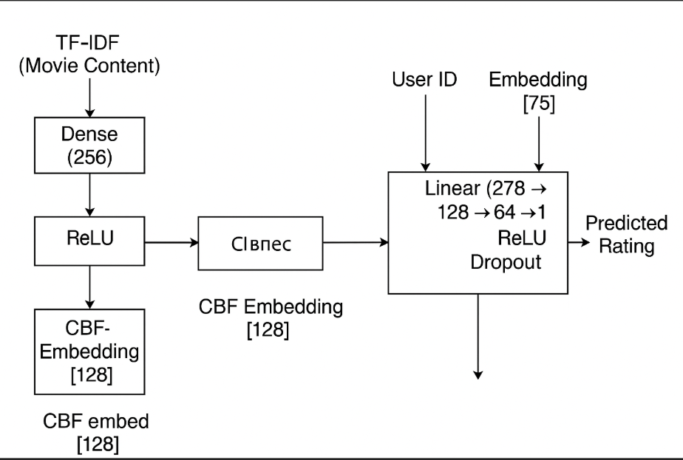
4. Hybrid Training (CBF + CF combined model)
Combines user embedding, movie embedding (from CF), and CBF embedding (from neural CBF).
The three vecto rconcatenated to form a single vector of size 278 (75 + 75 + 128).
This combined vector is passed through two dense layers: Linear(278 → 128 → 64 → 1)
with ReLU and Dropout.
The entire model is trained end-to-end using MSELoss on scaled ratings.
The optimizer used is Adam with a learning rate of 0.001.

Slide 15
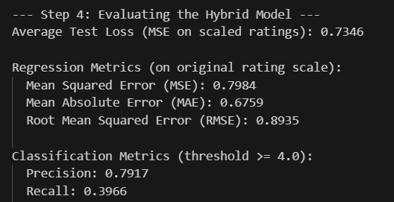
EVALUATION
Regression Metrics are Calculated The model is evaluated using RMSE, MAE, and R² Score to measure how close the predicted ratings are to the actual ratings.
Classification Metrics are Also Used Ratings are converted into binary values: 1 if rating ≥ 4.0, 0 if rating < 4.0. Then, Precision, Recall are calculated to measure how well the model recommends "liked" movies.
The values which you got in the output :

Slide 16
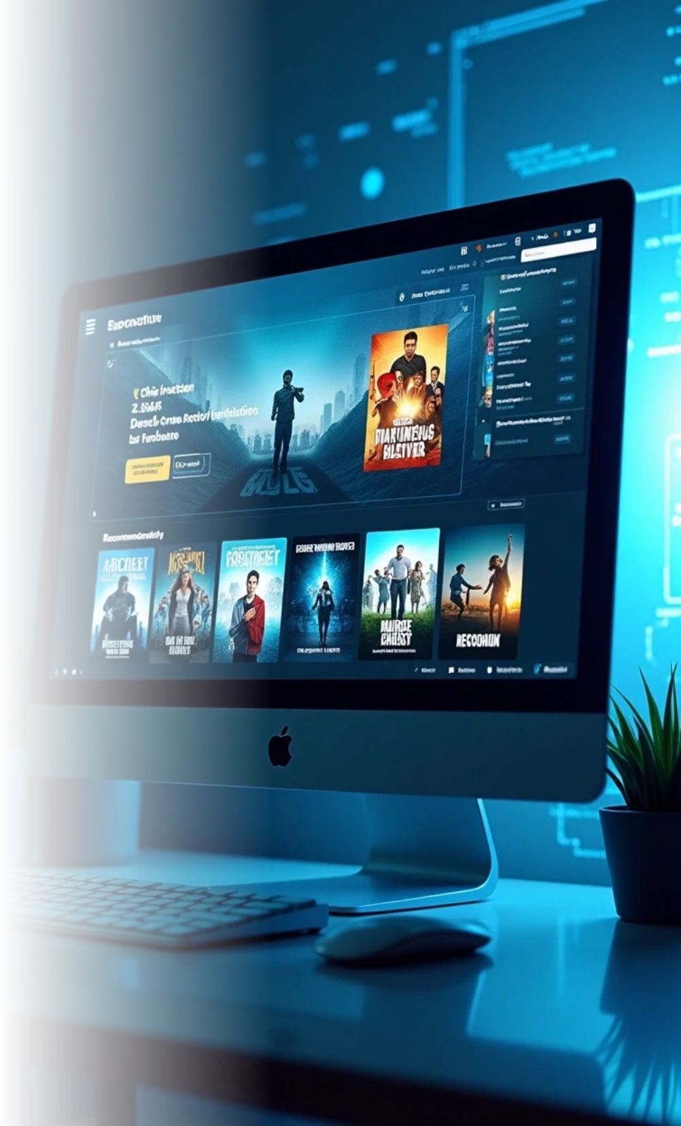
Deployment
Flask Framework is Used The model is deployed as a web application using Flask, a lightweight Python web framework

Slide 17

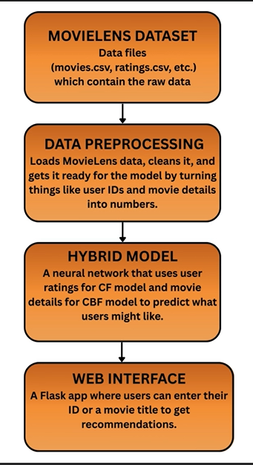
Data Flow Diagram
.

Slide 18
05
RESULTS AND DISCUSSION

Slide 19
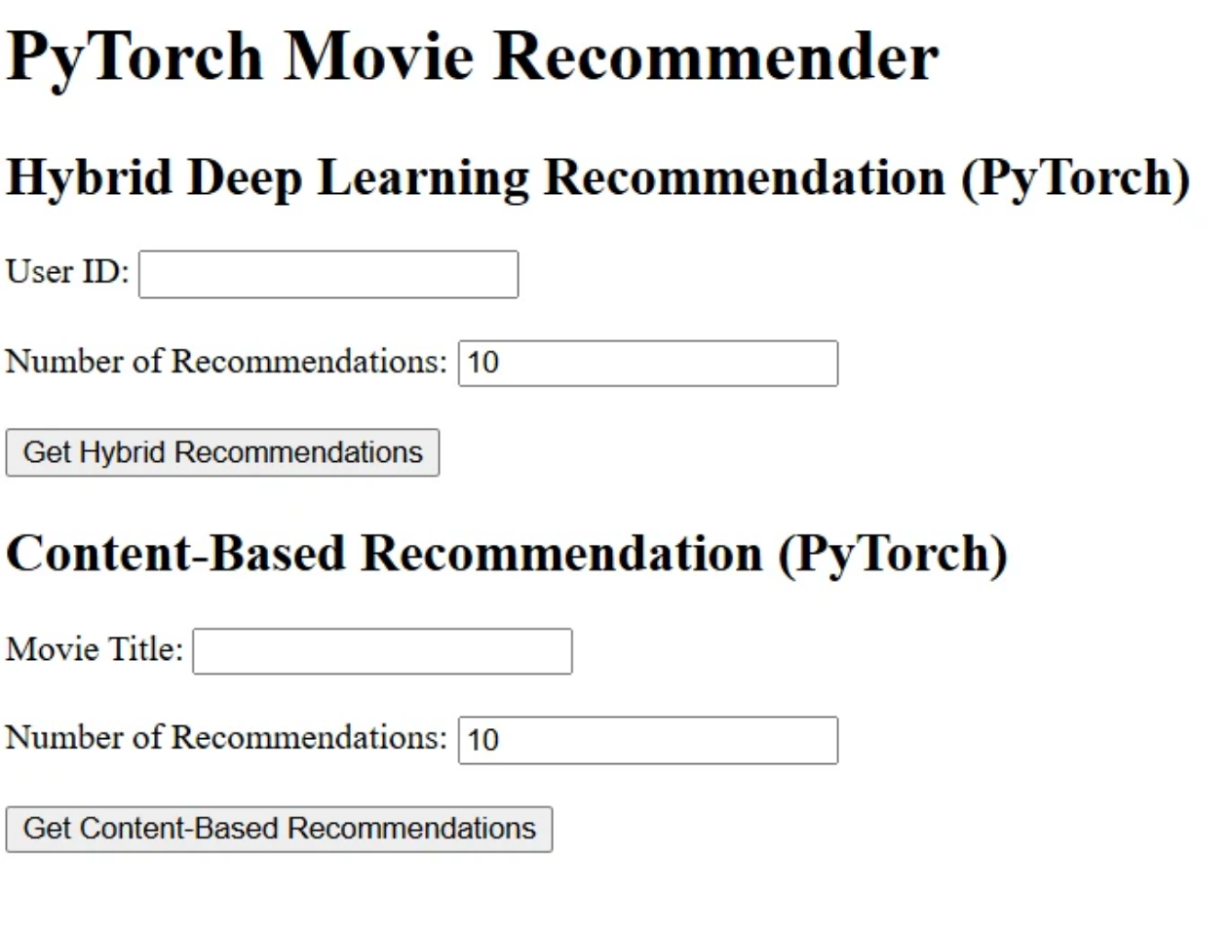
Recommendation Dashboard
The Flask app has a simple web page where users can enter their ID or a movie title to get recommendations. It shows a form for input and lists the suggested movies with their predicted ratings or similarity scores.

Slide 20

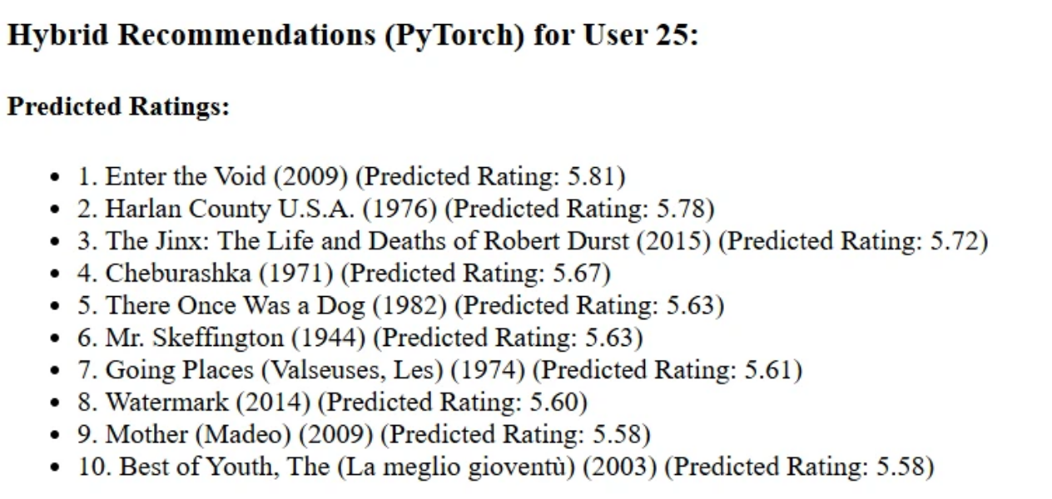
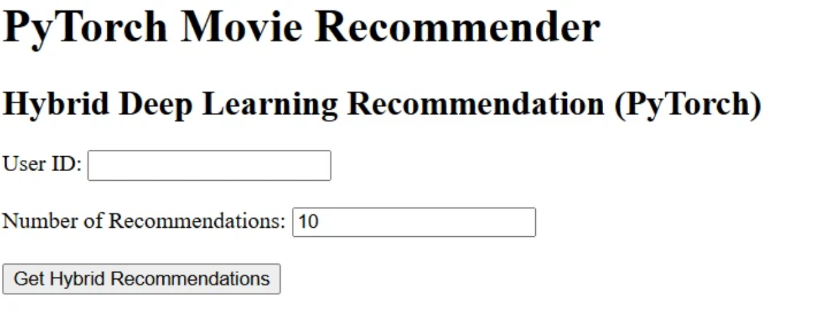
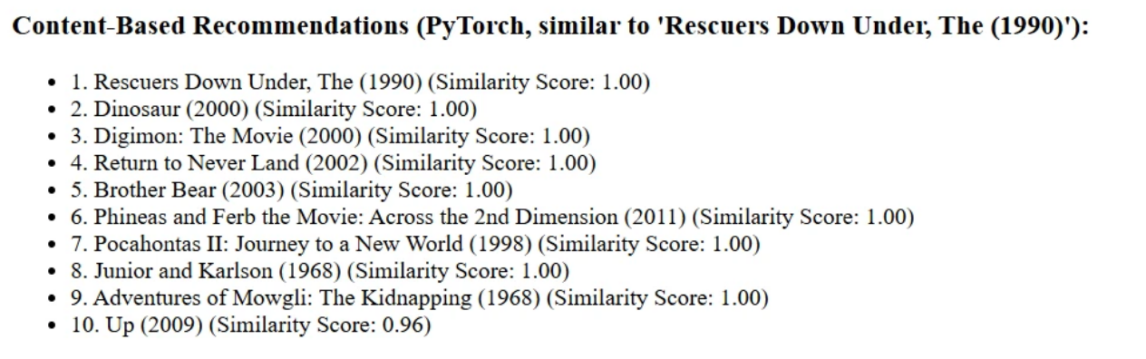
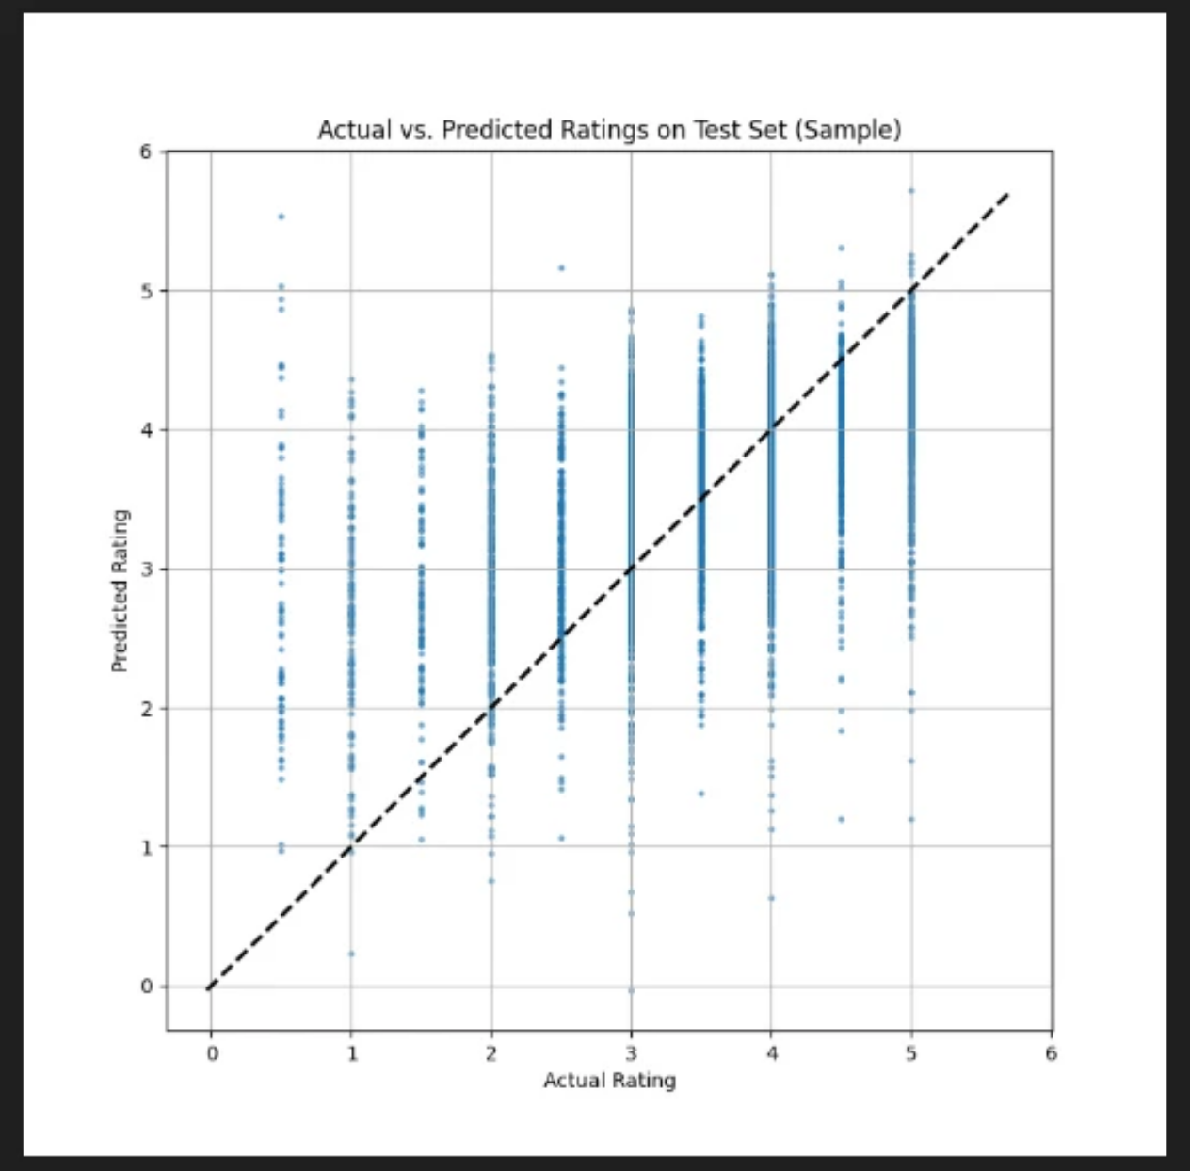
Output
The system works great and does two things:
• Personalized Recommendations: Suggests the top N movies for a user based on their ratings.
Content-Based Recommendations: Finds movies similar to one I pick, like an anime movie, by looking at genres or descriptions.
Here’s a graph showing how close the model’s predictions are to actual ratings:

Slide 21

Challenges Faced
Building the project had some tough moments:
Data Issues: Some movies in the MovieLens dataset were missing details, like descriptions.
Model Balance: Making the collaborative and content-based parts
work together was hard.
cold start problem : Most of the data hasn’t rated any movies yet, the
system doesn’t know their preferences

Slide 22

06
CONCLUSION

Slide 23

Summary
This project taught me a lot:
• How to build recommendation systems using deep learning
• How to use PyTorch to create neural networks that predict things like movie ratings
• How to make a web app with Flask so others can use my system easily.
• How to check if a model is good using numbers like MSE, MAE, and RMSE.
This experience has made me more confident in machine learning, and I’m excited to work on more projects in the future.

Slide 24

Thank You

